Slide 1
Classification: Practical Issues -- Model Training and Evaluation

Slide 2
Review from last time
We learned the importance of dataset curation/cleaning
Understood how to handle situations with very little data
Small dataset overall
Imbalanced classes
Understood why and how to do feature reduction
Understood why and how to do feature engineering

Slide 3
In this lecture you will learn about:
Model training and selection
When are you overfitting/underfitting your dataset
Bias vs variance tradeoff
What are reasonable performance boosts
How to tune your models
Saving and loading a trained model
Model evaluation
Cross Validation, statistical significance
Performance metrics
Confusion matrices
Model debugging

Slide 4
Data selection/curation is “probably more important” than model tuning,
But, it is incredibly easy to achieve terrible model performance/generalization by
Violating the constraints of the model (and/or choosing the wrong model)
Testing and training on the same data, i.e., “I cured cancer today”
Using your holdout set as your test/validation set
Massively overfitting

Slide 5
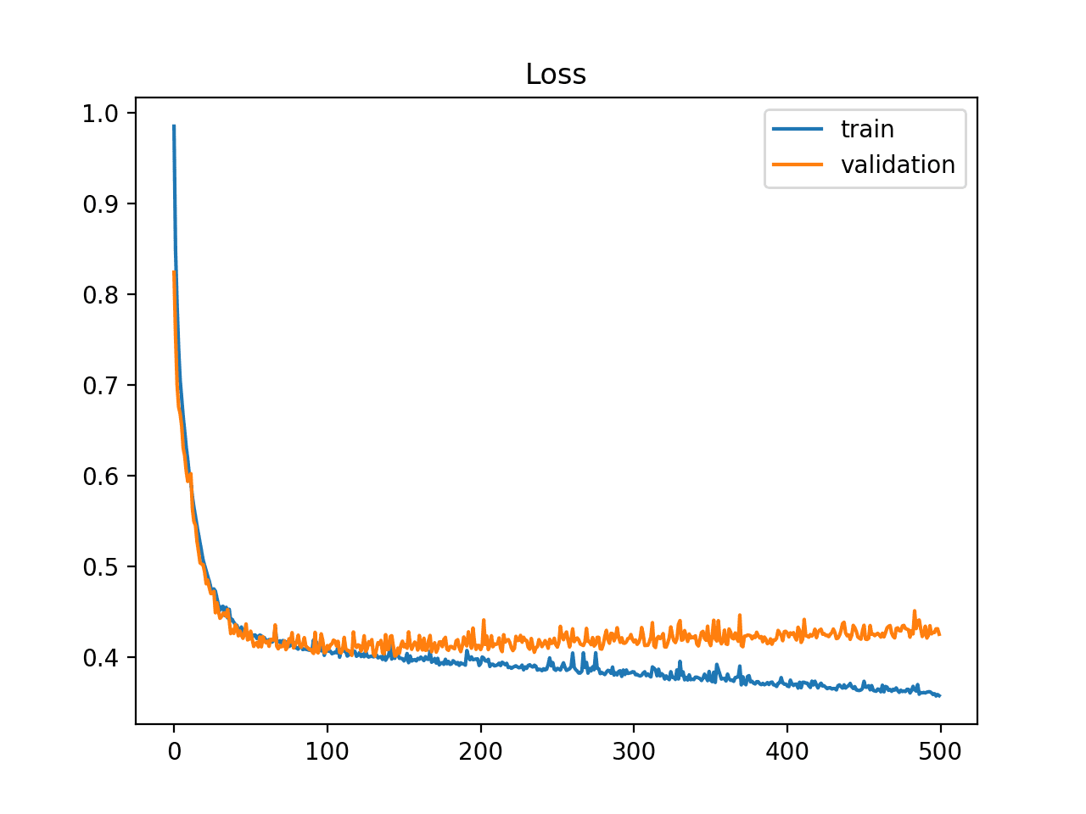
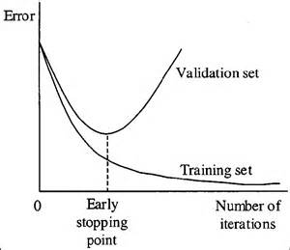
How do I know if I am overfitting to my data?
Generally happens when the model is allowed to “learn too much”
We can visualize this happening with train and validation datasets (in part, the reason to have the latter):
Images from
https://elitedatascience.com/overfitting-in-machine-learning
https://machinelearningmastery.com/learning-curves-for-diagnosing-machine-learning-model-performance/

Slide 6
How do I know if I am overfitting to my data?
Compare your score on the training set against the validation set
As you train, if you’re using something like a neural net that can be “stopped early”
At the end of training, if you’re using something like a RandomForest -- early stopping is implemented here by controlling the depth of the trees/etc.
If you are overfitting:
Consider a weaker model that is less capable of memorizing your data
Consider adding more data
Consider stopping the model early during training
Then, re-train the model and check for improvement on the validation set
Do not touch the holdout data until you’re completely done training and tuning your model!

Slide 7
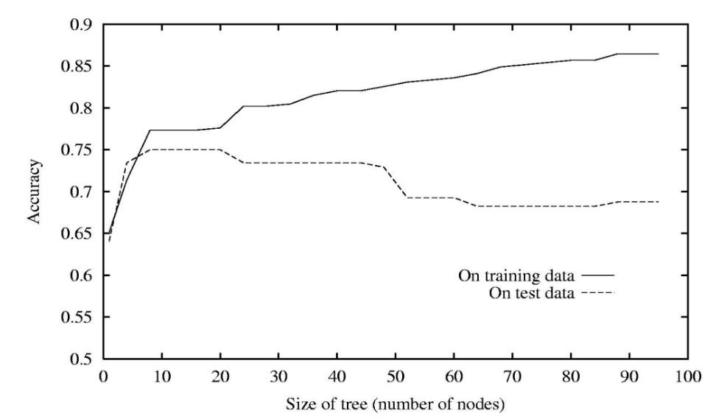
Visualizing overfitting for Decision Trees
You can graph the training vs validation performance as you modify parameters of the tree:
Image from http://www.cs.umd.edu/class/spring2018/cmsc422-0101//slides0101/lecture03.pdf

Slide 8
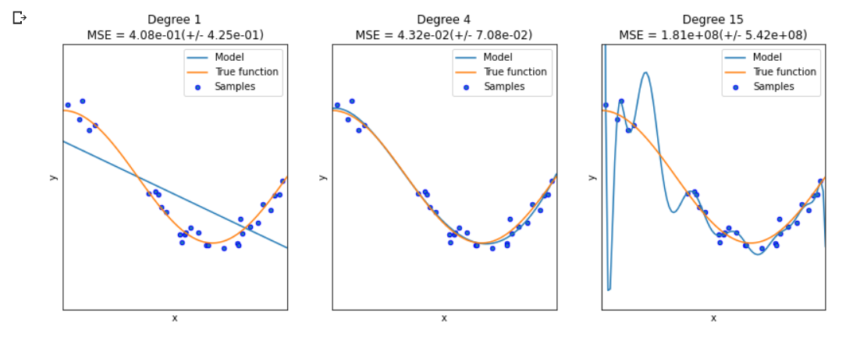
What about underfitting?
Overfitting typically means that you see “great performance” on your training dataset, and much poorer performance on your validation set
You can also underfit: here the model you’re selecting is not powerful enough to capture the relationship of your dataset
For example, trying to fit a line (linear regression) to model a relationship that isn’t linear
Underfitting can also happen when your model hasn’t trained enough and training loss is still decreasing
Images from https://datascience.foundation/sciencewhitepaper/underfitting-and-overfitting-in-machine-learning

Slide 9
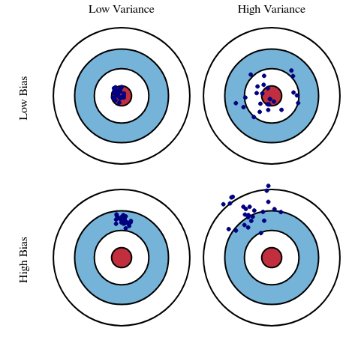
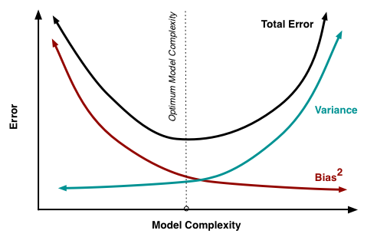
Model performance: bias and variance
Model error is the sum of two errors:
VARIANCE [estimation error]: how far off is this model from the optimal model of this type
BIAS [approximation error]: the error from the optimal model of this model type
There is a tradeoff between bias and variance
Bias is reduced and variance is increased as model complexity grows (as more parameters are added)
Related to over- and under-fitting your models
Images from http://scott.fortmann-roe.com/docs/BiasVariance.html

Slide 10
How much performance improvement can you expect?
How good are humans at your task?
Using an immature model setup (wrong model, wrong parameters, etc) can yield “obviously poor” results sometimes
Or, if you get extraordinarily high performance, I’d be suspicious...
But if you haven’t done anything majorly wrong, how do you know if you can build a better model
This lecture, we’ll see how we can run experiments to tune our models
For mature models (SOTA), researchers can often publish papers with very small improvements in performance
See the chart at the end of https://www.iqt.org/bio-nlp-highlights-and-summary-from-acl2020-part-ii/
Getting a 1-2% performance boost in the real world can be huge

Slide 11
Better performance through parameter tuning
Re-training your models with different values for their parameters is frequently done to improve performance
However, there are infinite combinations of parameters to try…
ML libraries often have an implementation of GridSearch to automate this process
Choose which parameters you want to tune
Choose the possible values for each parameter (now the setup looks like a grid)
Try all possible combinations, reporting the best one
Raw GridSearch is a brute force algorithm that can take a long time to run, especially if it takes a long time to train a single model
Active research area: optimizing how this search is done by learning from the “mistakes” of earlier trained models

Slide 12
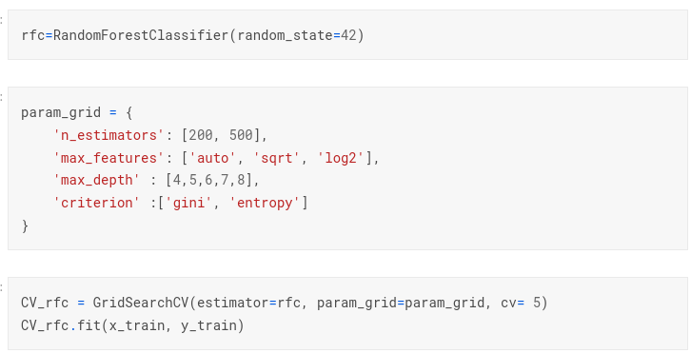
GridSearch with RandomForests in scikit-learn

Slide 13
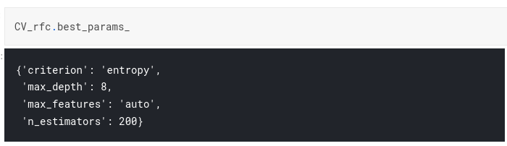
GridSearch with RandomForests in scikit-learn

Slide 14
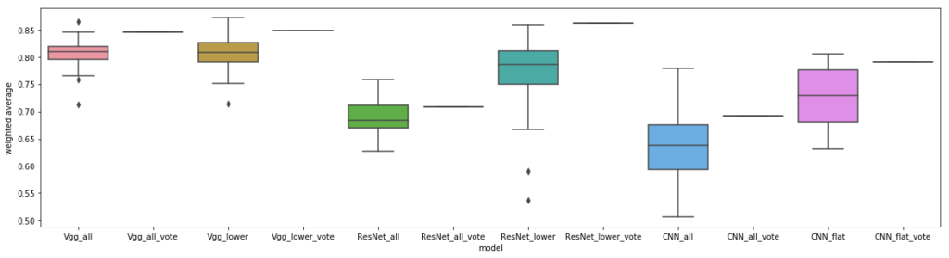
Cross Validation
There are multiple sources of randomness during model training:
The split into training-validation (and holdout)
The randomness of the models themselves [what’s an example?]
As you saw in your homework, scores can vary
How do you know your parameter tuning is a real improvement, not just noise from this randomness?
Option 1: prevent all randomness
You have to have high confidence that your data split is reasonable here to get away with this…
Option 2: cross validation
Train multiple versions of the same model on different splits of the data into training and test
You can then evaluate your results with some basic statistics like confidence intervals
You will likely even want to do this once you’re done tuning your parameters

Slide 15
Measuring performance for classification
Accuracy: how many labels did your model get correct?
Weighted accuracy: giving equal weight to all classes? [imbalanced datasets]
Precision, recall, and harmonic mean (F1 score) – next slide
Sometimes precision or recall might be more important, depending on your domain
Example: diagnosis of COVID19 from a rapid test -- want to label all sick patients correctly, even if we mis-label some healthy patients
Example: accusing someone of fraud -- maybe it’s more important we never accuse an innocent person, than catching all criminals?
ML libraries typically have implementations of these kinds of scoring metrics for you to use, and more:
You pass in the ground truth labels and your predictions, and it reports the score
https://scikit-learn.org/stable/modules/model_evaluation.html#classification-metrics

Slide 16
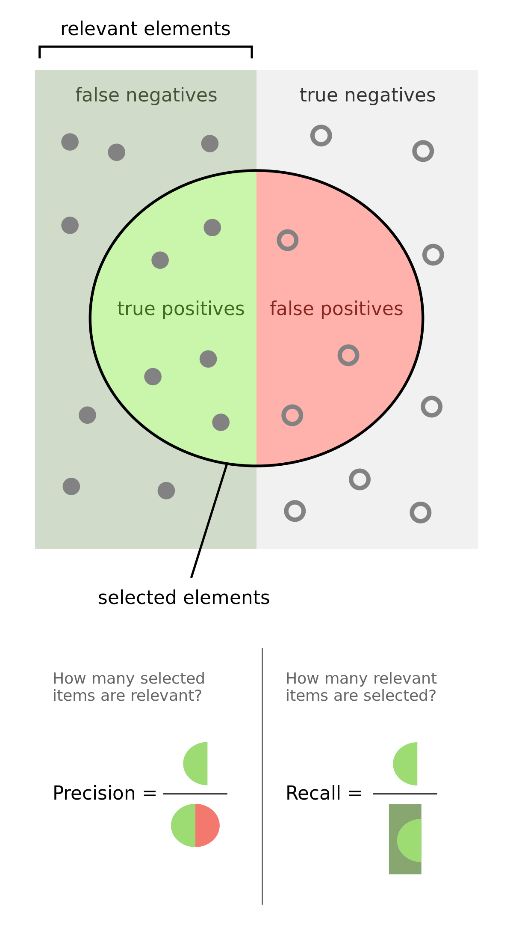
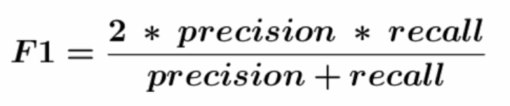
Precision, Recall, F1-score
Are often more meaningful measures of classification performance than accuracy
Accuracy = (TP + TN) / (all predictions)
Precision: of all the positive elements you flagged, how many were legit?
Examples for a medical test?
Recall: of all the positive elements you flagged that were legit, what percent were these were collected?
Examples for a medical test?
F1-score: the harmonic mean of precision and recall

Slide 17
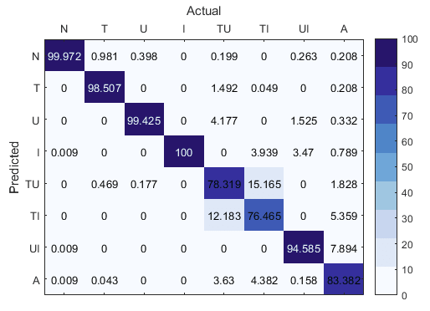
Measuring performance for classification: confusion matrix
Gives you an idea (especially for multi-class classification) which classes were most frequently mislabelled as which other classes:
Image from Javiad, “A Deep Learning Based DDoS Detection System in Software-Defined Networking (SDN)”

Slide 18
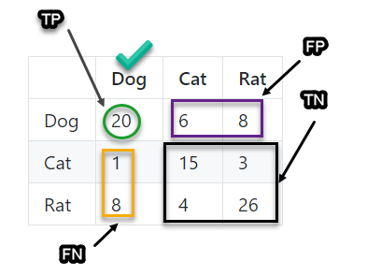
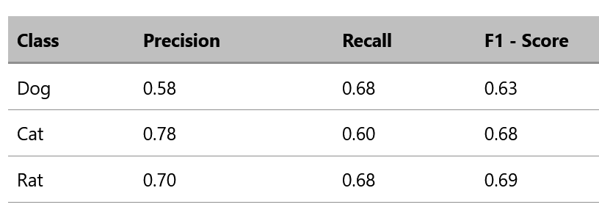
Precision and Recall for multi-class classification
As we just saw, these metrics are “traditionally” used for binary classification problems
You have other options for multi-class, non-binary classification, using the confusion matrix:
ground truth
model prediction
Images from https://gkadusumilli.github.io/Confusion_matrix/

Slide 19
Debugging your models
We’ll cover this in more detail later in the semester
Some practical suggestions:
Graph your training loss, rather than training accuracy, if you want to check that your model is learning more directly [for neural nets]
Manually generate toy datasets where it is easy to verify the accuracy/scoring manually

Slide 20
Homework for next class
Homework 3 due (Homework 4 due next Wednesday)
Exam 1 next class
Will mostly be on theory; may ask you explain python code on slides (don’t need to regurgitate the code, however)
Covers all material through today
Study the slides and your notes from class
Sample exam has been posted
Project 1 due after the exam (Feb 14) – mark the due date in your calendars!
For group projects, you should aim to, by Feb 14:
Have your data collected by this point
Clean your data
Split your data into train/test/CV/etc
Finish all the gradic rubric points up to “Discuss and implement how you will handle any dataset imbalance”
You should basically do everything to get ready to instantiate and train your model(s)
Complete all points in grading rubric through item 14

Slide 21
Homework 4: In-class exercise in groups of 2-3 students [5 mins]
Using the mental health dataset from last class:
Split the data into train, validation, and holdout
Train your model on the training dataset
Score your model on the validation dataset
Write a short paragraph on did your model overfit or not (or state it is impossible to tell and why)
Modify your code from earlier to start a run of GridSearchCV
Tune at least five different parameters
Each parameter should have 2-4 possible values
Report your results in improvement over your baseline accuracy, if any
Submit to blackboard
One submission per team with all team members’ names on it please

